Slide 1
Impact of High PV Penetration on Distribution Systems
Final Presentation
Client: Alliant Energy
Advisor: Dr. Venkataramana Ajjarapu

Slide 2
Team 46
Daniel Tott
Major: Electrical Engineering
Team Role: Team Leader
Nathan McGlaughlin
Major: Electrical Engineering
Team Role: Webmaster
Jasleen Grover
Major: Electrical Engineering
Team Role: Key Concept
Holder 1
Minsung Jang
Major: Electrical Engineering
Team Role: Key Concept
Holder 2

Slide 3
Problem Statement
The Problem
Use of solar energy is increasing.
Variable nature of solar energy causes voltage problems.
Alliant Energy desires to add more solar energy to their distribution systems.
Our Solution
Simulate distribution systems using OpenDSS.
Add instances of high PV penetration to the systems.
Note where voltage violations occur and find solutions.
Provide design explaining solutions and general guidelines for future implementations of solar energy.

Slide 4
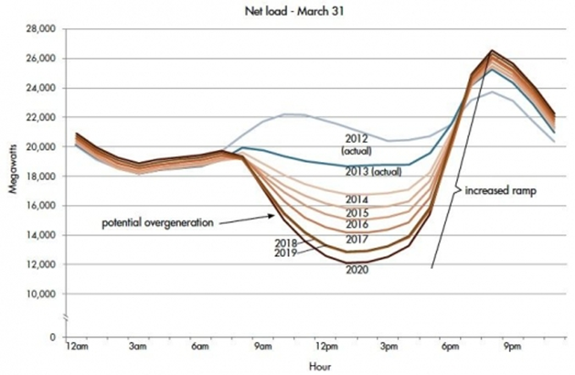
Conceptual Sketch - California Duck Curve
https://www.energy.gov/eere/articles/confronting-duck-curve-how-address-over-generation-solar-energy
Notes:
Net load is the total load subtracted by the solar power.
Effect has been seen strongly in California
Adding large amounts of solar, even 40% of all electricity generation has been seen.
Increase in solar is putting stress on existing systems.
Between 9:00 A.M. and 12:00 P.M.
Rapid increase in solar power while load is relatively low and decreasing in some cases
Possible overvoltage as other power sources need to decrease production.
After 6:00 P.M.
Rapid increase in total load as people have gotten home while solar starts decreasing
Possible undervoltage as other power sources need to increase production.

Slide 5
Goals
Simulate the IEEE 34 node test feeder with solar.
Simulate 500+ node Alliant Energy distribution system with added instances of solar energy.
Find solutions to keep voltages between 0.95 and 1.05 per unit for the IEEE 34 system, and 0.985 and 1.05 for the Alliant system.
Find solutions that keep the amount of tap changes of the voltage regulators relatively low in the interest of extending the life of the voltage regulators.
Design generalized solutions for adding solar energy to a system such as location of the solar and utilizing smart inverters, and adding capacitors in certain areas.
Notes:
We want to simulate the IEEE 34 bus system
Been heavily researched.
Add different instances of PV penetration in different locations.
Make changes to system to see effects.
Simulate an Alliant Energy distribution system.
Already has solar, adding more
Experiment with removing existing solar and replacing with a 1 MW community solar farm.
Between 0.95 and 1.05 for IEEE 34. Between 0.985 and 1.05 for Alliant (higher standards)
-

Slide 6
Deliverables
Voltage profiles and other relevant plots of simulations without added solar, with residential solar added, and with community solar added.
Detailed comparison of community vs. residential solar energy being added to the system.
Data showing the decrease of voltage violations and regulator tap changes after creating solutions to problems that arise after adding solar to a system.
Details of potential, future modifications to Alliant Energy’s distribution system as deterrents to voltage violations that can occur with the addition of solar.
Notes:
Doesn’t need to go in depth.

Slide 7
Functional Requirements
Implement the IEEE 34 Node system and Alliant system in OpenDSS.
Load profiles, 24 hour simulation, monitors to track voltage profiles, tap changes, voltage violations, and substation power.
Add instances of high PV penetration to the distribution systems.
Add smaller PV systems to certain loads to simulate residential solar, and also separately add a 1 MW community solar farm.
Design solutions that arise from adding high PV penetration.
Location of solar, use of inverters, regulators, and capacitors.
Use MATLAB to count number of tap changes and voltage violations.
Data from OpenDSS is exported into Excel .csv sheets, and MATLAB code detects and counts tap changes and violations.
Notes:
Our first requirement is we need to be able to analyze the distribution systems in OpenDSS.
We have to provide load profiles to run a 24 hour simulation.
And need monitors to track voltage profiles, tap changes, voltage violations, and the substation power.
We have to be able to simulate solar energy in our systems, as both residential and community solar power.
Have to be able to create a design for how to find solutions to high PV penetration.
Need MATLAB to count the number of tap changes and voltage violations.

Slide 8
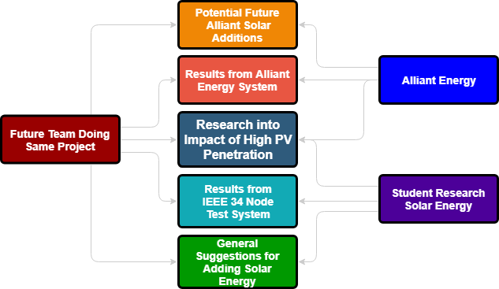
Use-Case Scenario
Notes:
So Alliant Energy is who we are mainly working on this project for, but it can also be used by others researching solar energy, and future Iowa State senior design teams doing the same project with Alliant Energy.
All of the results from this project could be used for future Iowa State senior design teams.
One of our results from our project is providing potential locations for Alliant Energy to add solar, which can be used by Alliant Energy.
Another is the results of our simulations of Alliant’s system for to be used by Alliant Energy.
Our research into the impact of high PV penetration could be used by anyone who is interested.
The results from the IEEE 34 node system would be good for other students to look into.
Also, our general solutions for adding solar energy would be something students would be interested in.

Slide 9
Design Plan
Simulate the base system, ensure that all components are working correctly, and analyze the results.
Document the number of tap changes and voltage violations.
Based on system analyzation, choose locations for PV systems believed to be significant, and simulate with multiple settings.
Document the tap changes and voltage violations, and choose another location.
Continue doing this until an ideal solar location with specified components added to the system is found.
Notes:
Our design plan is to first simulate and analyze the base system.
Then we can document the number of regulator tap changes and voltage violations in the base system.
After analyzing the base system, we choose locations for PV systems, and simulate the distribution system with them.
Then we document the number of regulator tap changes and voltage violations and try different locations.

Slide 10
Design Diagram
Notes:
Here is a design diagram showing our general design and how we look at the base system, choose places to add solar, and try it with different components such as smart inverters to add Volt-VAR control.
We compare the base system with the system that includes solar, and the system with different modifications to it.

Slide 11
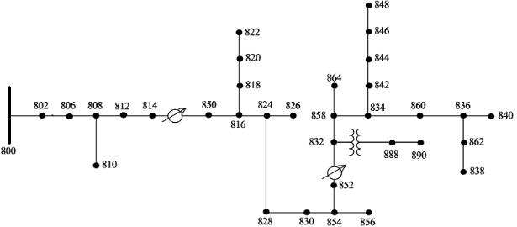
System Overview - IEEE 34 Node System
25,000 kVA generator
34 nodes, 28 loads
Two transformers
Two 3 phase voltage regulators
Two shunt capacitors at 844 & 848
Both spot and distributed loads
Notes:
Reasons why we chose this system:
Typical rural distribution system which is common in Iowa.
Heavily relies on the two voltage regulators to maintain a good voltage profile.
Good for looking at tap changes.
This feeder is very long and lightly loaded and has unbalanced loading which can result in convergence problems.

Slide 12
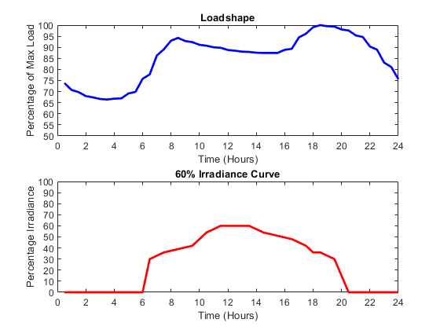
Initial Adjustments to IEEE 34 Node System
Included a typical 24 hour loadshape.
Created multiple irradiance curves that would simulate the effects of different amounts of sunlight on the PV systems.
Added a capacitor to load 890 to fix undervoltage issues.
Notes:
Needed a 24 hour loadshape to properly analyze system over the course of a day.
Added an irradiance curve to simulate the change in PV power in the system.
Noticed load 890 commonly was having low voltage issues.
This was especially happening around 6:00-9:00 P.M. when the load was increasing.
Adding a shunt to load 890, which was at the end of a line, fixed this issue.

Slide 13
Community Solar
Add 1 MW community solar farm to IEEE 34 node system.
Add directly next to generator source (Node 802).
Add near middle of system at light load (Node 816).
Add near end of system at heavy load (Node 844).
Simulate at irradiance levels of 20%, 40%, and 60%.
Simulate at unity power factor (UPF) with normal inverters and with Volt-VAR control using smart inverters.
Notes:
In order to simulate community solar energy we added a 1 MW solar farm to the IEEE 34 node system in different locations for different simulations.
We added one directly next to the generator, one near the middle of the system at a light load, and one near the end of the system at a heavy load.
Some of the major points of the PV systems are we simulated it at different irradiance levels of 20%, 40%, and 60%.
We also ran the PV systems both with normal inverters at unity power factor, and with smart inverters that allow Volt-VAR control.
Volt-VAR control improves power quality by managing reactive power flow, and lowering voltages closer to the 0.95 ANSI standard per unit voltage.
Simulate community, 1 MW solar farm different locations
Next to gen, middle of system-light, end of system-heavy
SImulated at irradiance levels of 20%, 40%, and 60%.
UPF and Volt-VAR
Improves power quality, manage Q flow, lowers voltages.

Slide 14
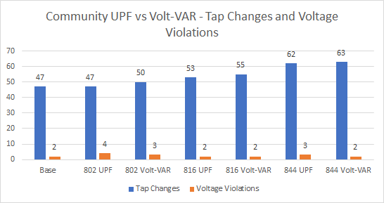
Community Solar - UPF vs Volt-VAR
Notes:
When the 1 MW solar farm was added to the system at node 802 next to the substation, there was the same amount of tap changes as compared to the base case with no solar.
However, we also saw more voltage violations due to undervoltage issues farther into the system.
At load 816 a little farther into the system, we saw an increase in tap changes, but less voltage violations than the previous case.
At load 844 near the end of the system, we saw a sizable increase in tap changes, but still not too many voltage violations.
Here the voltage regulator for the 2nd transformer was seeing a large increase in tap changes due to the load change around 6:00 P.M.
1 MW solar farm at 802, same tap changes as base
More voltage violations, undervoltage farther into system
816 little farther, increase tap changes, less voltage violations.
844 near end, sizable increase tap changes, ~voltage violations.
2nd regulator working lot around 6:00 P.M. and on.

Slide 15
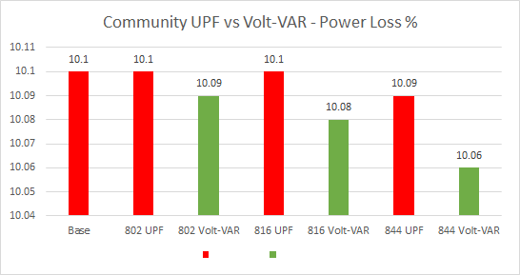
Community Solar - Power Loss
UPF Volt-VAR
Notes:
Here’s an additional slide to show a nice thing about smart inverters using Volt-VAR mode.
Lowers power loss by keeping voltages lower.
Nicer in more compact systems where voltages change quickly on smaller lines, but still has a decent impact here.
Nice thing about smart inverters.
Lowers power loss by keeping voltages lower.
More noticeable in compact systems.

Slide 16
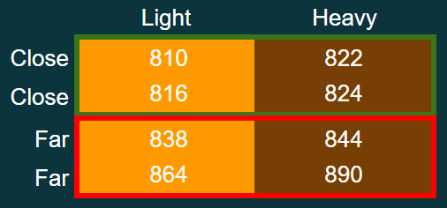
Residential Solar
Res 1 - 4 Light Loads
Res 2 - 4 Heavy Loads
Res 3 - 2 Close, Light Loads
2 Close, Heavy Loads
Res 4 - 2 Far, Light Loads
2 Far, Heavy Loads
Notes:
To simulate residential solar we made 8 PV systems with 4 different configurations of 4 PV systems each.
The first configuration, named Res 1, was made up of 4 light loads.
Res 2 was 4 heavy loads.
Res 3 was all loads closer to the substation, with 2 light and 2 heavy loads.
Res 4 was all loads far away from the substation, with 2 light and 2 heavy.
And the results shown in this presentation will be from simulations with 60% PV penetration.
8 PV systems, 4 configs of 4 PV systems
1st configuartion, Res 1, 4 light
Res 2, 4 heavy
Res 3, all close to sub, 2&2
Rest 4, all far from sub, 2&2
Results with 60% PV penetration.

Slide 17
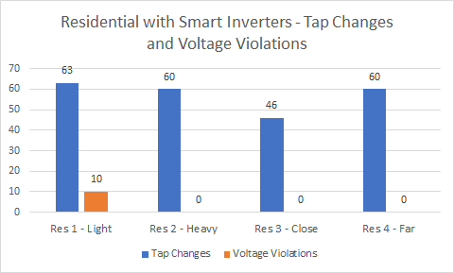
Residential Solar
Notes:
When we placed all the residential PV systems at the light loads throughout system, we saw the worst results.
There was a large amount of tap changes, and 10 voltage violations.
In the 3 other simulations, smaller instances of solar being placed at heavy loads helped to regulate the system.
From our results, we saw that placing residential PV systems at heavy loads, close to the substation would be ideal for this system.
PV at light loads, worst results.
Large # tap changes, 10 voltage violations.
Other 3, small instances of solar at heavy loads helped regulate.
From results, PV at heavy loads close to substation ideal.

Slide 18
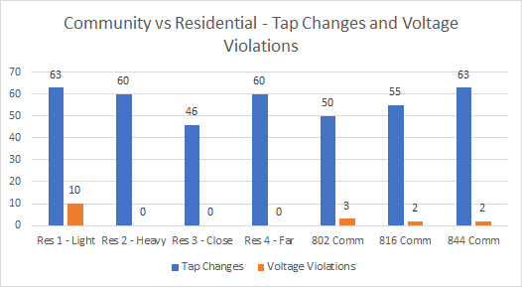
Community vs Residential
Notes:
Here we compared community and residential PV systems.
On average, the residential PV systems had a similar amount of tap changes as a community solar farm.
As far as voltage violations, one configuration of residential PV systems being at light loads had 10 voltage violations, but otherwise we saw 0 voltage violations in systems with residential PV systems.
We can see that with an ideal PV system configuration, residential solar can function better than community solar.
Compared community and residential PV systems.
On average, residential PV systems has similar amount of tap changes.
With voltage violations, 1 had 10, but rest had 0.
With ideal PV system configuration, residential can function better than.

Slide 19
Community vs Residential
Community solar is a large commitment and can cause problems.
Solar farms mostly need to be placed close to a substation in a system.
Increases the number of tap operations and voltage violations.
Residential solar is more flexible and can potentially improve system.
Residential PV systems don’t have a relatively large, individual impact.
In ideal configuration, can lower number of tap operations have 0 violations.
Notes:
Comparing community and residential solar, we see community solar as a large commitment that can cause problems, whereas residential solar can be more flexible and potentially improve a system in some areas.
In community solar, solar farms ideally need to be placed close to a substation, where residential PV systems, don’t have a large impact on their own and depending on the output, can usually be placed wherever.
Also community solar is bound to increase the number of tap operations and voltage violations, whereas residential solar can potentially lower the number of tap operations and have 0 voltage violations.
Community large commitment w/ problems, Residential flexible and improve in some areas.
Solar farm need to be by substation, Residential PV systems don’t have large impact.
Community increase tap changes & violations, In ideal configuration, Residential lowers.

Slide 20
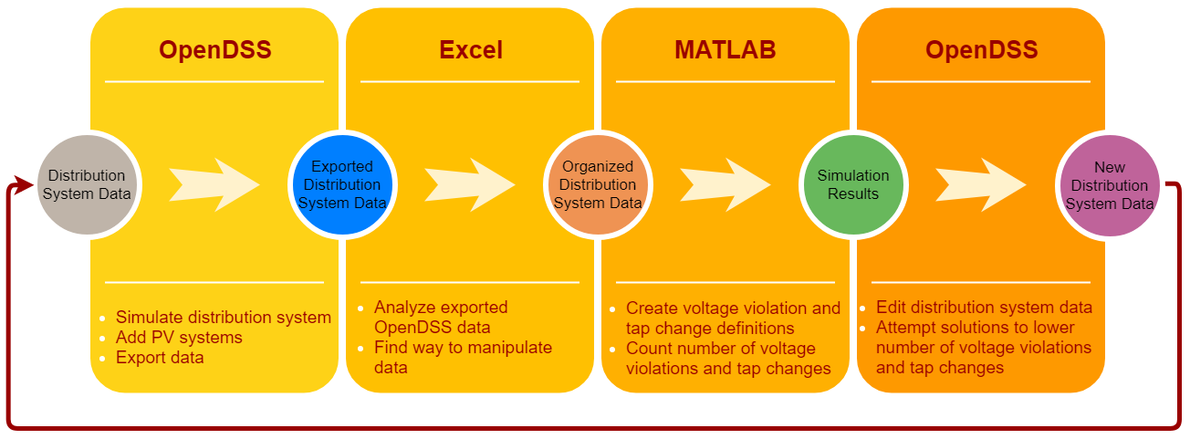
Implementation

Slide 21
Testing
Test system is modeled correctly. Snap solution, total active power, compare to IEEE results and Alliant results from Synergi.
Test that PV is being injected into system correctly. Snap solution for total solar power subtracted from total active power.
Ensure 24 hour solution and load curve is working correctly. Load curve and irradiance curve changes every hour. Calculate total active power from substation and compare to total hourly calculations.
Calculate losses, tap changes, and voltage violations for base case compared to with PV.

Slide 22
Testing Results
Results of testing and research showed that correct results were being received from the simulations.
Impact of changing load curve and PV power showed through instances where majority of voltage violations and regulator tap changes would be seen.
Use of capacitors and smart inverters had expected results.
Different locations of PV systems correlated with previous studies on IEEE’s 34 node system.

Slide 23
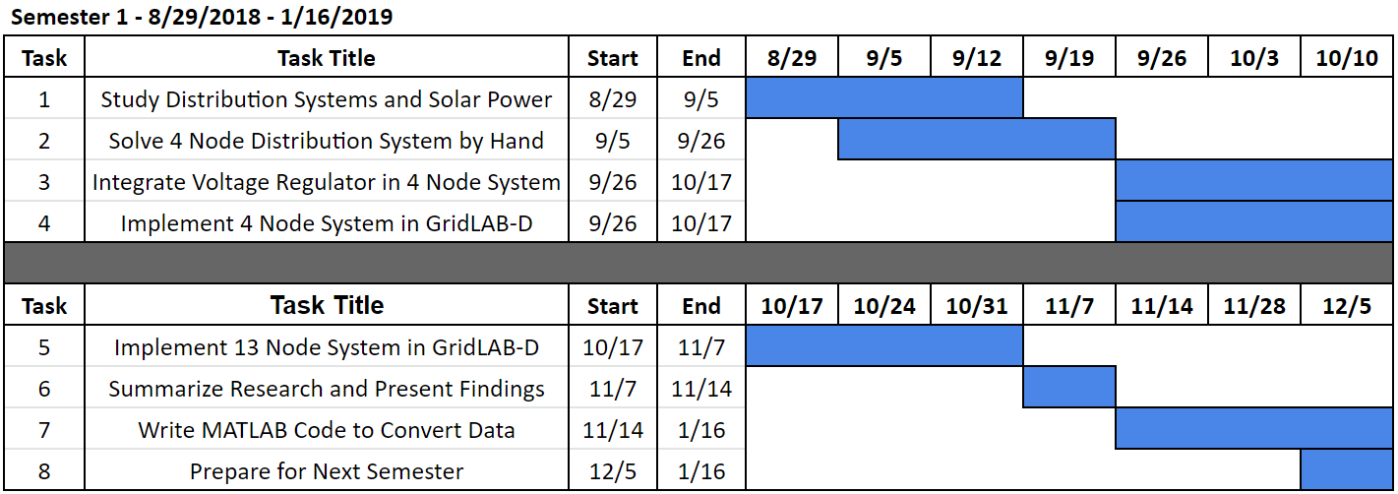
Semester 1 Schedule

Slide 24
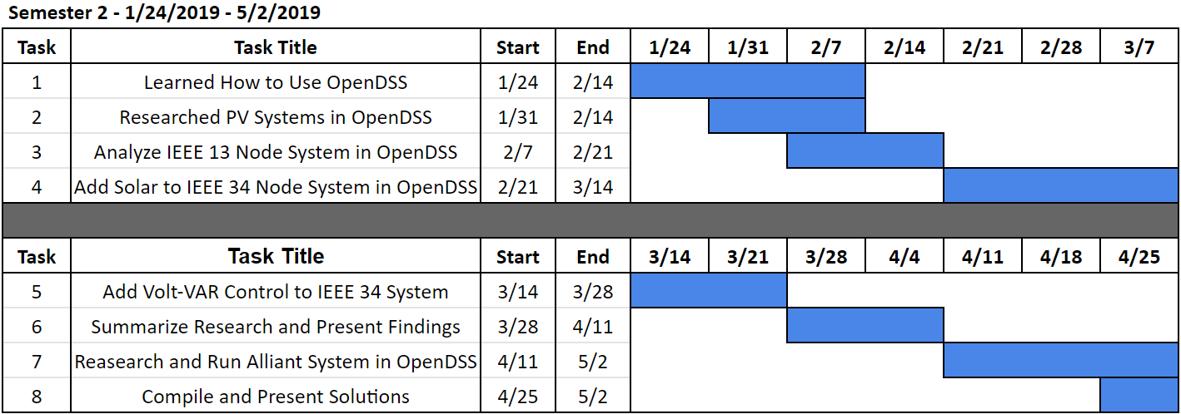
Semester 2 Schedule

Slide 25
Conclusion
Our results coincided with a lot of research that has been done into high PV penetration.
Useful for Alliant with their specific system that they had us simulate.
This project can be built on by future senior design teams.
Look into providing a loadshape for each loads.
Simulate more with different weather and seasons.
Great learning experience for working with teams for a long-term project.
Notes:
Our results coincided with a lot of research that has been done into high PV penetration.
Useful for Alliant with their specific system that they had us simulate.
This project can be built on by future senior design teams.
Look into providing a loadshape for each loads.
Simulate more with different weather and seasons.
Great learning experience for working with teams for a long-term project.

Slide 26
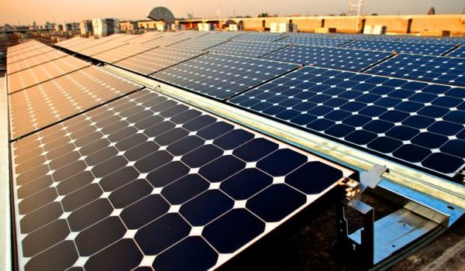
Questions?

Slide 27
References
“Confronting the Duck Curve: How to Address over-Generation of Solar Energy.”
Office of Energy Efficiency and Renewable Energy,
www.energy.gov/eere/articles/confronting-duck-curve-how-address-over-generation-
solar-energy.
Distribution System Analysis Subcommittee. (1992). IEEE 34 Node Test Feeder. 1-16.
Aggarwal, V. (2019, April 24). Solar Panel Efficiency: What Panels Are Most Efficient?
EnergySage. Retrieved April 29, 2019, from
https://news.energysage.com/what-are-the-most-efficient-solar-panels-on-the-market/

